Slide 1
Assignment2 – WEEK1
Pass I – Macro processor

Slide 2
Lab Assignment 2
Design suitable data structures & implement pass-I of a two-pass Macro processor.

Slide 3
Macro Processor (PASS –I Only) Nested Macro Calls Only
(NO NESTED MACRO DEFINITIONS)

Slide 4
(Simple) Example1 : No NESTED MACRO CALLS / No Parameters (for PRACTICE only- TRY it OUT)
//INPUT
MACRO ADDS
MOVER AREG, =‘1’
ADD AREG,=‘2’
MOVEM AREG, X
MEND
MACRO SUBS
MOVER BREG, X
SUB BREG, Y
MOVEM BREG,X
WRITE Y
MEND
START 200
READ N1
READ N2
ADDS
SUBS
N1 DS 2
N2 DS 2
N3 DS 2
N4 DS 2
END
PASS1 – Input-Output
PASS1 TASK
STORE the MACROS in MNT, MDT
MDT
MOVER AREG, =‘1’
ADD AREG,=‘2’
MOVEM AREG, X
MEND
MOVER BREG, X
SUB BREG, Y
MOVEM BREG,X
WRITE Y
MEND
0
1
2
3
4
5
6
7
8
MNT
Macro Name | MDT Pointer
ADD2 | 0
SUBS | 4
START 200
READ N1
READ N2
ADDS
SUBS
N1 DS 2
N2 DS 2
N3 DS 2
N4 DS 2
END
0
1

Slide 5
Assignment 2: WEEK1
Given input file (Next slide)
Perform Pass – I on the given file, by Scanning it and correctly filling the
MNT
MDT
Intermediate Code(IC) (output file)
Print the above 3 things generated MNT, MDT and the Output File - IC

Slide 6
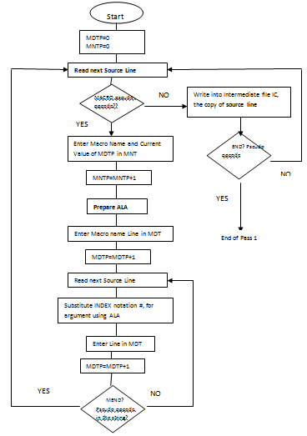
Flowchart of PASS-I of Macro processor

Slide 7
Assign2-Week1 : With NESTED MACRO CALLS
//INPUT FILE –Ass2- Week1
MACRO INCR &A,&B,&REG=CREG
MOVER &REG,&A
ADDS1 &A,&B
MOVEM &REG,&A
MEND
MACRO ADDS1 &C,&D
MOVER AREG, &C
ADD AREG, &D
MOVEM AREG, &D
WRITE &D
MEND
MACRO SUBS1 &C1,&D1
MOVER BREG, &C1
SUB BREG, &D1
MOVEM BREG, &D1
WRITE &D1
MEND
START 200
READ N1
READ N2
ADDS1 N1,N2
SUBS1 N1,N2
READ N1
READ N2
INCR N3,N4,DREG
STOP
N1 DS 2
N2 DS 2
N3 DS 2
N4 DS 2
END
PASS1 – Input-Output
PASS1 TASK
STORE the MACROS in MNT, MDT, generate IC
MDT
INCR &A,&B,&REG=CREG
MOVER #2, #0
ADDS1 #0, #1
MOVEM #2, #0
MEND
ADDS1 &C,&D
MOVER AREG, #0
ADD AREG, #1
MOVEM AREG, #1
WRITE #1
MEND
SUBS1 &C1,&D1
MOVER BREG, #0
SUB BREG, #1
MOVEM BREG, #1
MOVEM BREG, #1
MEND
0
1
2
3
4
5
6
7
8
9
10
11
12
13
14
15
16
MNT
Macro Name | MDT Pointer
INCR | 0
ADDS1 | 5
SUBS1 | 11
0
1
2
START 200
READ N1
READ N2
ADDS1 N1,N2
SUBS1 N1,N2
READ N1
READ N2
INCR N3,N4,DREG
STOP
N1 DS 2
N2 DS 2
N3 DS 2
N4 DS 2
END

Slide 8
Thank you!!
Submission:
Create 1 doc file, add code + screenshot and submit on VOLP

